Slide 1
ecmc Open Source Motion Control
Based on the Etherlab open source EtherCAT master (www.etherlab.org)
Anders Sandström
ESS Motion Control and Automation Group
www.europeanspallationsource.se

Slide 2
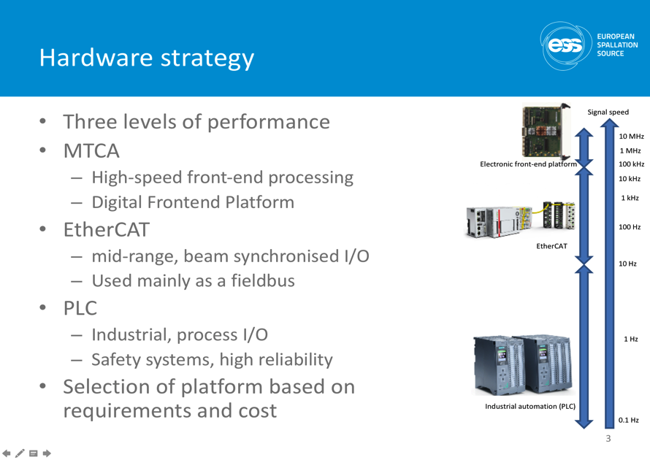
EtherCAT at ESS
Chosen as a medium performance platform for data acquisition and control [3, 4].
Ideal for Motion Control.
Source: [5]
2
Notes:
2

Slide 3
ecmc: EtherCAT Motion Control
ecmc is an open source motion control framework for EPICS environment [10].
Functionalities:
Motion (with or w/o EPICS Motor Record support):
Positioning (absolute, relative)
Constant speed
Referencing sequences
Motion (extension to Motor Record)
Motion interlocks
Triggering, latching positions
Synchronization axis to axis
Synchronisation to external source (timing system)
General
Data acquisition (analogue <100kHz, digital <1Mhz)
General I/O + low level control by scriptable PLC objects or direct from EPICS
SDO , Oversampling terminals
3
Notes:
Will focus on the talk on motion functionalities
3

Slide 4
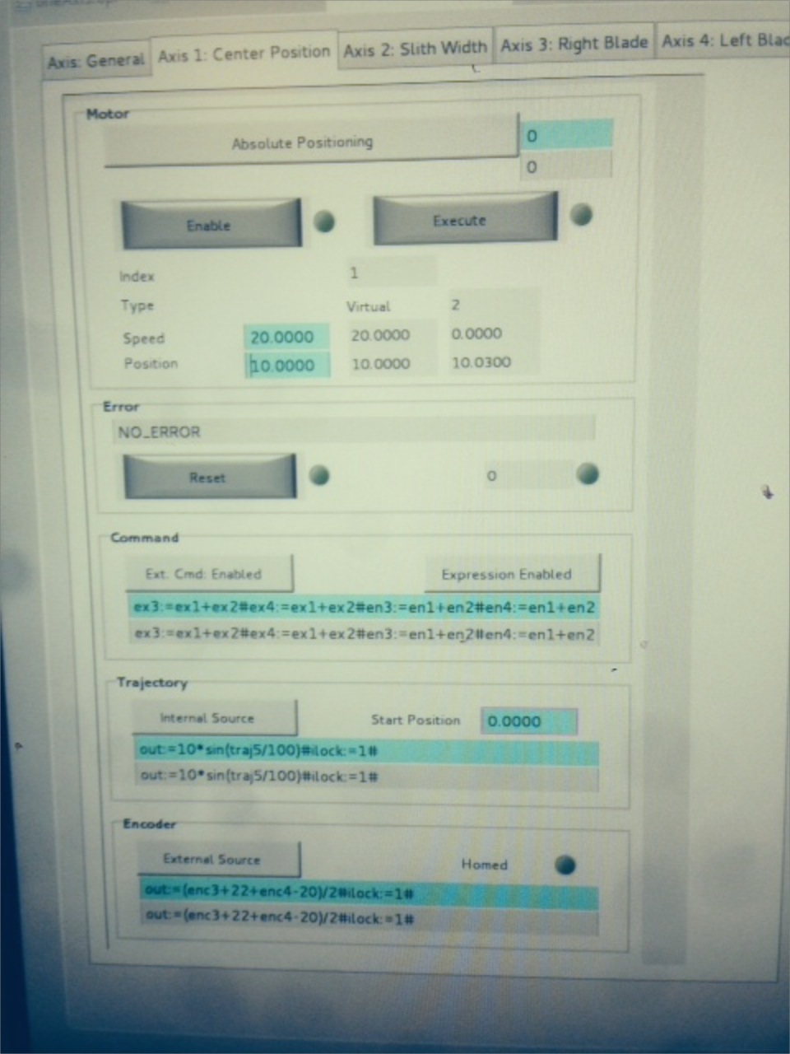
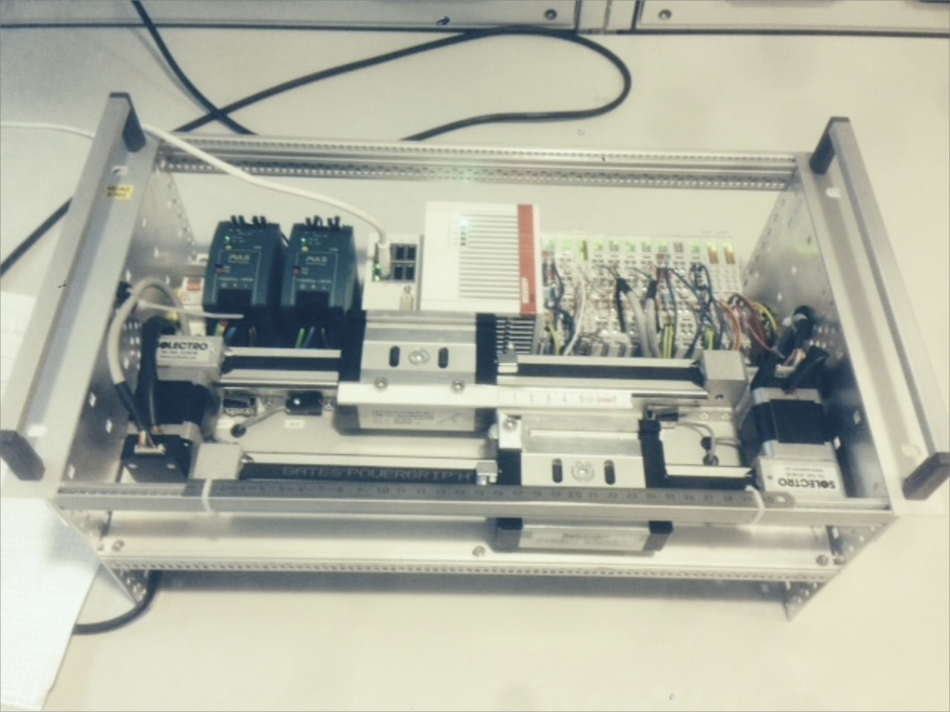



ecmc: Overview
HMI (CSS, BOB)
Channel Access
Linux Controller (Centos 7 RT kernel)
EPICS IOC
asynPortDriver
Motor model 3 drv
asyn
Motion, general control, DAQ
(ecmc)
Igh open source EtherCAT master
(www.etherlab.org)
EtherCAT
EtherCAT Terminals
EtherCAT Terminals
EtherCAT Drive
Analog
Analog
Drive
Digital
XXXX
Drive
Digital
XXXX
4
Notes:
This slide shows an overview of our current system architecture.
The Motion Control algorithms then links to the open source EtherCAT master from Etherlab.
The EtherCAT master is used for configuring the ethercat bus and sending/reciving data from EtherCAT slaves. Typical slaves could be drives (stepper BLCD, pulse direction, analog or digital data)
All softwares in the controller is open source EPCIS, drivers, ECMC and etherlab.

Slide 5
ecmc: Architecture
Linux Controller
Iocsh conf. cmd:
“ecmcConfigOrDie()”
EPICS records
EPICS motor records
ecmcMotorRecord
Motor model 3 drv.
asynPortDriver
Interfaces
asynoctet
asynint32
asynfloat64
asynarrayxxx
command parser
ecmc Core
Real Time Thread (1kHz)
Axis 1
Axis 2
Axis n
PLC 1
PLC n
EtherCAT process image
EtherCAT master / User space
EtherCAT
Kernel
5
Notes:
Slide shows ECMC architecture.
ECMC is integrated into EPICS using asynportdriver base class which is part if the asyn framework.
Configuration is made through the ioc shell command ecmcConfiOrDie(). This command I communicating to ecmc through the asyn octet if which forwards the commands to a command parser. The command parser then reads/writes the setting according to the current command.
Motor record is also using the asynoctet interface and command parser.
All other EPICS record types are communicating to ecmc through the standard dedicated asyn interfaces for the different data types (also arrays and I/O intr).
ECMC holds a copy of the current process image to where the axis-and plc objects and epicsrecords can read and write to.
The process image is updated (read and write) through a user space interface supplied by the etherlab master.

Slide 6
ecmc: Control Features
EPICS: All data accessible directly as process values that can be linked to logic or GUI in EPICS layer (including motor record)..
PLC: Loadable plc files (exprtk syntax, similar to PASCAL):
Plugins: C/C++ custom code loadable:
CNC g-code support by grbl
SocketCAN support (inc. reduced CANOpen support
FFTs by kissfft:
Raspi wiringPi support
PVA support from ecmc-plc
Simple scope for ethercat dc slaves
ecmc motion NC
6
Notes:
Later also CCDB

Slide 7
ecmc: PLCs: Simple Example Code:
if(plc0.firstscan){ # Initiations
plc3.enable:=0; # Block other plc
ax1.blockcom:=1; # Block Epics Communication for axis 1
println('Startup sequence PLC0 starting!’); # Print Diagnostics
};
var blink_cycles:=1/plc0.scantime; # Local variable (losses value between cycles)
var warning_light:=ec0.s2. binaryOutput04;
ec0.s2. binaryOutput08:=ec0.s1. binaryInput01 and ax1.enc.actpos>0; # Set output
static.counter+=1; # Static variable (keeps value between cycles)
if(static.counter>=blink_cycles)
{
warning_light:=not(warning_light);
static.counter:=0;
plc0.error:=123; # PLC error code
};
global.test:=warning_light; # global.test is accessible in all PLC objects
ec0.s2. binaryOutput04:= warning_light; # Output will flash in 1Hz
mc_move_abs( 1,1, 100.0,10.0,1,1); # Move axis 1 to target pos 100 at a velo of 10.
……
7

Slide 8
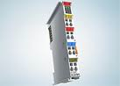
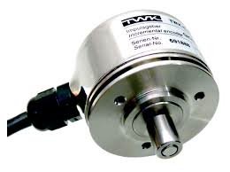
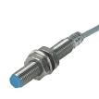
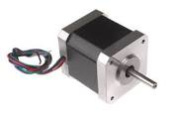
ecmc: Axis object
“Cfg.CreateAxis(…)”
Axis
Types: Normal, Virtual
Encoder
Trajectory
PID-Control
Monitor
Drive
Optional Axis PLC for syncronization / control (executed in sync with axis object)
ECPdoEntry
ECPdoEntry
ECPdoEntry
ECPdoEntry
ECPdoEntry
ECPdoEntry
ECPdoEntry
ECPdoEntry
ECPdoEntry
EC master
EC master
EC master
Executes and links objects:
Encoder
Trajectory Generation
PID-Controller
Monitor
Drive
Sequences
Homing (different types)
8
Notes:
Like I said, the axis object links and executes certain other objects like Encoder, trajectory, PID-control, monitor and Drive.
The encoder typically links to an analog input value from a slave. Could be an encoder, analog input or any input.
The Trajectory object generates trajectory setpoints for the motion.
The PID- controller controls based on the error between the trajectory generated setpoint and the actual value from the encoder object.
The monitor object monitors the motion and the drive links to an output value of a slave. Could be a stepper module or analogoutput, pulse direction.
Different versions of axis object have been implemented: Normal, Virtual, Encoder, Trajectory.
Each axis also have a dedicated PLC object allocated that could be used for synchronizations and other tasks.

Slide 9
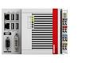
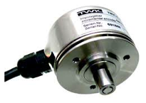
ecmc: Control Loop Execution Options
CSP-Mode
Cyclic Sync. Position
CSV-Mode
Cyclic Sync. Velocity
CST-Mode
Cyclic Sync. Torque
- Trajectory gen.
- No control
-Trajectory gen.
-Position cont.
-Trajectory gen.
-Position cont.
-Velocity cont.
Act. position
Position setp.
Act. position
Velocity setp.
Act. position
Torque setp.
Amplifier
Level
Control:
Pos.
Velo.
Torque
Control:
Velo.
Torque
Control:
Torque
Controller: No loops needed
Drive: All control loops
Controller: Position loop
Drive: Velocity and current loop
Controller: Position, velocity loop
Drive: Current loop
9

Slide 10
ecmc: Synchronization
Normal axis:
Controller
Drive
Trajectory
Encoders
Monitor
Virtual axis:
Trajectory
Encoder
Monitor
Synchronization is handled through PLCs objects.
Each axis object have a dedicated “Axis PLC”-object that is executed just before the axis object.
Axis PLC objects behave exactly as normal PLC objects.
Any Axis PLC or Normal PLC object can be used for synchronization (or other PLC code).
Execution flow:
Read from EC
Axis PLC 1
Axis 1
Axis PLC 2
Axis 2
Axis PLC n
Axis n
PLC 1
PLC 2
PLC n
Write to EC
10
Notes:
Encoder axis could be a timing system
Future ideas:
Axis group..

Slide 11
ECMC: Synchronization
Synchronization of axes is handled by a axis synchronous PLC:
ax<id>.traj.setpos = Trajectory generated setpoint for axis x
ax<id>.enc.actpos = Actual position of axis x
ax<id>.drv.enable = Enable amplifier of axis x
ax<id>.mon.ilock = Motion interlock of axis x (allowed to move if true)
ax<id>.mon.ilockfwd = Motion interlock of axis x (allowed to move forward if true)
ax<id>.mon.ilockfwd = Motion interlock of axis x (allowed to move backward if true)
Update of expression at runtime, evaluated in 1kHz.
Examples:
Slaving: ax2.traj.setpos := ax1.enc.actpos;
Synchronization: ax2.traj.setpos := ax1.traj.setpos;
Gearing: ax2.traj.setpos := 0.5 * ax1.traj.setpos;
Phasing: ax3.traj.setpos := ax1.traj.setpos + ax2.traj.setpos;
Advanced: ax1.traj.setpos := 10*sin(ax2.traj.setpos + ax3.enc.actpos);
Timing system: ax1.traj.setpos := ec0.s3.VALUE * 0.5 + ec0.s4.AO_1;
Interlocks: ax1.mon.ilock := ax2.mon.ilock and ax5.mon.ilock and ax4.enc.actpos > ax3.enc.actpos;
Enable: ax2.drv.enable := ax1.drv.enable;
Enable alternative: mc_power(1,ax1.drv.enable);
11

Slide 12
ecmc: Configuration
All configuration in EPICS startup file:
ECMC configurations
(hw, samplerate and nc settings
likespeed, acceleration, …..)
Terminal configurations
(Service Data Object access:
max current, mode…)

Slide 13
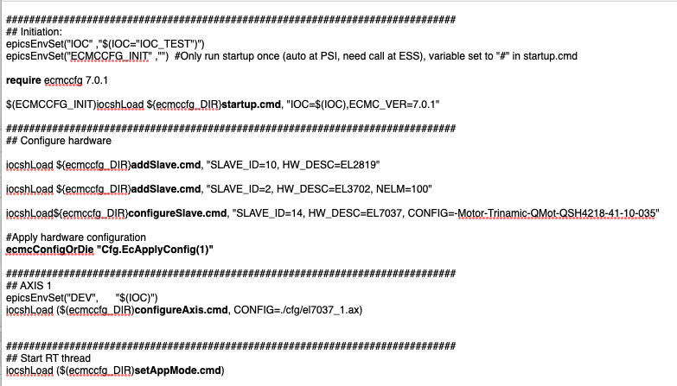
ecmc: Typical startup file
13
Notes:
Later also CCDB

Slide 14
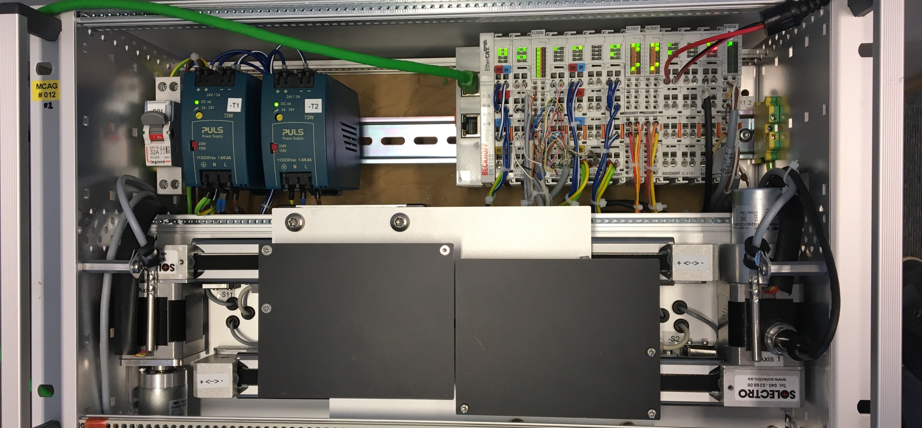
Application: 2-Axes Slit Set
2 virtual axes
Slit center position
Slit gap/opening
2 normal axes (blade positions)
Axis 1 (Virt: Center position)
Forward Kinematics:
ax3.traj.setpos:=ax1.traj.setpos - ax2.traj.setpos/2;
ax4.traj.setpos:=ax1.traj.setpos + ax2.traj.setpos/2;
Inverse Kinematics:
ax1.enc.actpos:=(ax3.enc.actpos+ax4.enc.actpos )/2;
ax2.enc.actpos:=(ax4.enc.actpos – ax3.enc.actpos);
Amplifier enable:
ax3.drv.enable:=ax1.drv.enable or ax2.drv.enable;
ax4.drv.enable:=ax1.drv.enable or ax2.drv.enable;
Or:
mc_power(3, ax1.drv.enable or ax2.drv.enable);
mc_power(4, ax1.drv.enable or ax2.drv.enable);
Axis 2 (Virt: Gap)
Axis 3 (Normal: Blade position)
Axis 4 (Normal: Blade position)
Blade
Axis 3
Blade
Axis 4
14

Slide 15
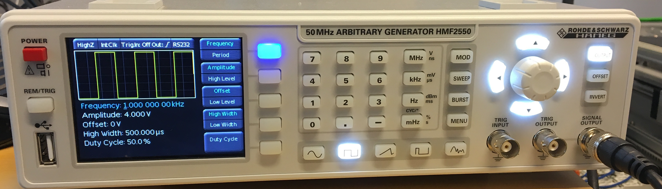
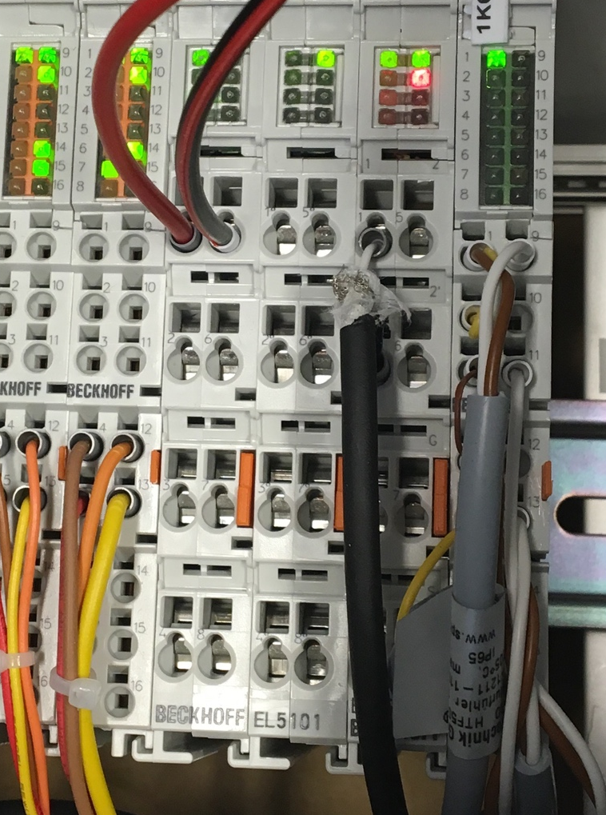
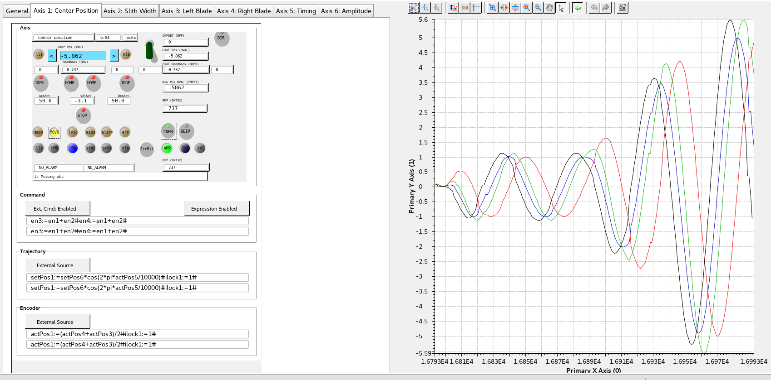
Application: 2-Axes Slit Set, External Sync.
Add 2 virtual axes
Timing system (Signal Generator connected to EL5101)
Amplitude
Axis 1 (Centre)
Axis 2 (Gap)
Axis 3 Left blade
Axis 4 Right blade
15
2 virtual axes:
External timing system (function generator)
Amplitude
§
2 virtual axes:
External timing system (function generator)
Amplitude
§
2 virtual axes:
External timing system (function generator)
Amplitude
§
2 virtual axes:
External timing system (function generator)
Amplitude
§

Slide 16
ecmc: Use cases
ESS:
Mostly small systems with approx. 30 slaves and a few motion axes
“High speed” several analog channels at 100KHz each
“Big system” 290+ slaves*
Multi master system*:
M0 130+ slaves
M1 70+ salves, 16 axes
Synchronizations: Iris with 6 physical axes + 3 virtual (x,y,aperature)
…
Foreseen to have 100+ systems at ESS
* Tuning needed
16

Slide 17
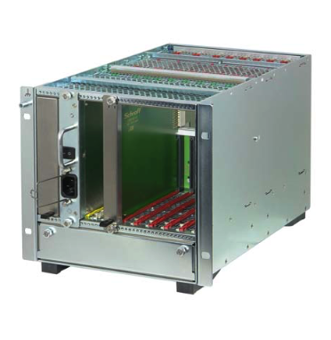
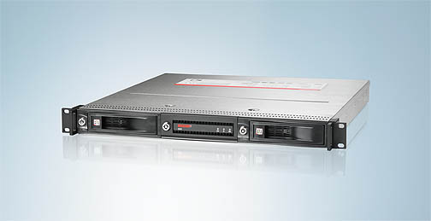
ecmc: Hardware Platforms
Standard computer hardware (NIC needed for EtherCAT Master).
Flexible hardware choice:
µTCA (not tested yet)
Industrial computer
DIN rail computer
Virtually any commercial EtherCAT slave (terminal) can be used, but needs to be evaluated and integrated into the framework.
17

Slide 18
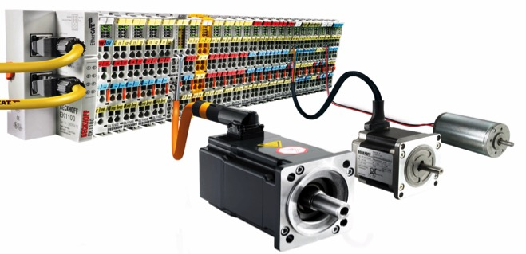
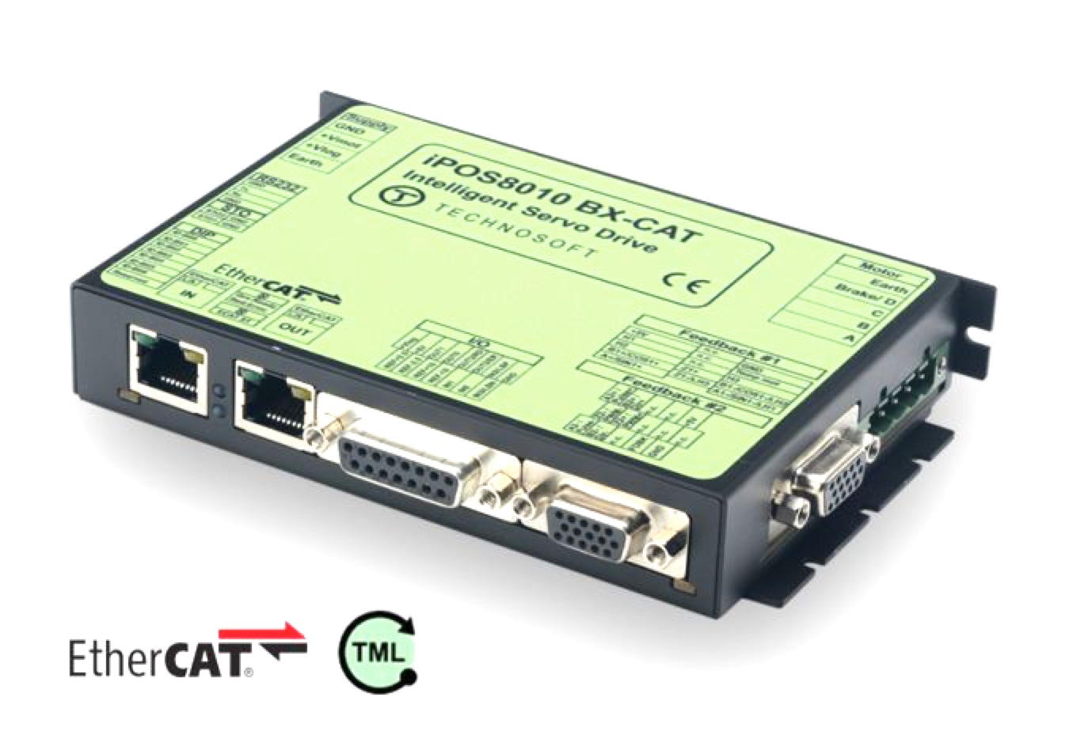
ecmc: Supported EtherCAT Slaves
Beckhoff I/O (analog and digital):
Normal and over-sampling, timestamped
Beckhoff position:
Absolute: SSI, Resolver
Incremental: AquadB, sin/cos 1Vpp
Beckhoff drives:
Stepper, BLDC/PMSM, DC: I_{rms}< 3.5A
Other Suppliers:
Kuhnke (stepper, BLDC, DC): I_{rms}< 5A
Technosoft (stepper, BLDC,DC): I_{rms} >5A
Micro Epsilon
SmarAct MCS2
Keyence
MonoDaq
PSI custom
http://www.beckhoff.com/
18
Approx. 150 slaves currently supported
http://www.technosoftmotion.com/
Notes:
Thanks

Slide 19
ecmc: Users
Users:
ESS (Mainly accelerator)
PSI (chosen as standard for SLS2 upgrade), collaboration
AVS (Spanish company)
Lund University (LIBAF, accelerator)
…
19
Notes:
Later also CCDB

Slide 20
Acknowledgments
Igh open source EtherCAT master (www.etherlab.org)
EPICS community (base, motor, asyn, stream device)
ExprTK C++ Mathematical Expression Library
(www.partow.net/programming/exprtk)
Questions?
20
Notes:
Thanks

Slide 21
References
[1] Beckhoff Automation GmbH, http://www.beckhoff.com
[2] EtherCAT Technology Group, http://www.ethercat.org
[3] D. Piso, S.L. Birch, A. Nordt, T. Gahl, P. Arnold, J. Weisend II, T. Korhonen, “ESS PLC controls strategy”, in Proc. IPAC’15, Richmond, VA, USA, May 2015, paper WEPMN061, pp. 3066-3068.
[4] T. Korhonen et al., “Status of the European Spallation Source Control System”, in Proc. ICALEPCS’15, Melbourne, Australia, Oct. 2015, paper FRB3O02, pp. 1177-1181.
[5] T. Korhonen, “ESS Controls hardware plans and status”, presented at the EPICS Collaboration Meeting, Oak Ridge, USA, Sept. 2016, unpublished.
[6] IgH EtherLab Components, http://www.etherlab.org
[7] R. Mercado, I. Gillingham, J. Rowland, K. Wilkinson, “Integrating EtherCAT based IO into EPICS at Diamond”, in Proc. ICALEPCS’11, Grenoble, France, Oct. 2011, paper WEMAU004, pp. 662-665.
[8] I. J. Gillingham, T. Friedrich, S. C. Lay, R. Mercado, “Experiences and lessons learned in transitioning beamline front-ends from VMEbus to modular distributed I/O”, in Proc. ICALEPCS’15, Melbourne, Australia, Oct. 2015, paper MOPGF019, pp. 121-124.
[9] D. Maier-Manojlovic, “Real-time EtherCAT driver for EPICS and embedded LINUX at Paul Scherrer Institut (PSI)”, in Proc. ICALEPCS’15, Melbourne, Australia, Oct. 2015, paper MOPGF027, pp. 153-156.
[10] A. Sandström, “Open Source Motion Control”, presented at the EPICS Collaboration Meeting, Lund, Sweden, May 2016, unpublished.
[11] EPICS: Motor Record and Device/Driver support, https://www3.aps.anl.gov/bcda/synApps/motor/index.html
[12] M. Rivers, asynDriver: Asynchronous Driver Support, http://www.aps.anl.gov/epics/modules/soft/asyn/.
[13] IEC 61800-7, part 7-1, part 7-200, part 7-300. Adjustable speed electrical power drive systems - Part 7: Generic interface and use of profiles for power drive systems.
[14] Arash Partow, C++ Mathematical Expression Toolkit Library (ExprTk), www.partow.net/programming/exprtk
21
Notes:
Thanks

